Slide 1
Introduction to Phyloseq
Daniel Vaulot
Notes:
Who has used R before ?
Who will work with several data sets ?

Slide 2
Why use R ?
Script vs. Menu driven software
Can be re-rerun with new data
R works with vectors and tables
Z <- X + Y where X and Y are vectors
"Tidy" worflow
Select(Tara_table, fraction="0.2-5")
Tidy "universe" : tidyverse
Incredible graphics and plots
ggplot2 family
Work environment
R studio
Document your data processing
R markdown
Share your data and workflow
GitHub

Slide 3
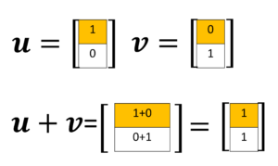
R works with vectors
station | fraction | diatoms | bolidos | stramenos | diatoms_pct
4 | Nano | 17165 | 12 | 17177 | 0.999
4 | Pico | 59786 | 1293 | 61079 | 0.979
72 | Nano | 6951 | 3 | 6954 | 1.000
72 | Pico | 3815 | 494 | 4309 | 0.885
Concept of data frame
Each column correspond to a vector
Some columns can be numeric, characters, dates
Creating new vectors
strameno<-diatoms+bolidos
diatoms_pct<-diatoms/strameno

Slide 4
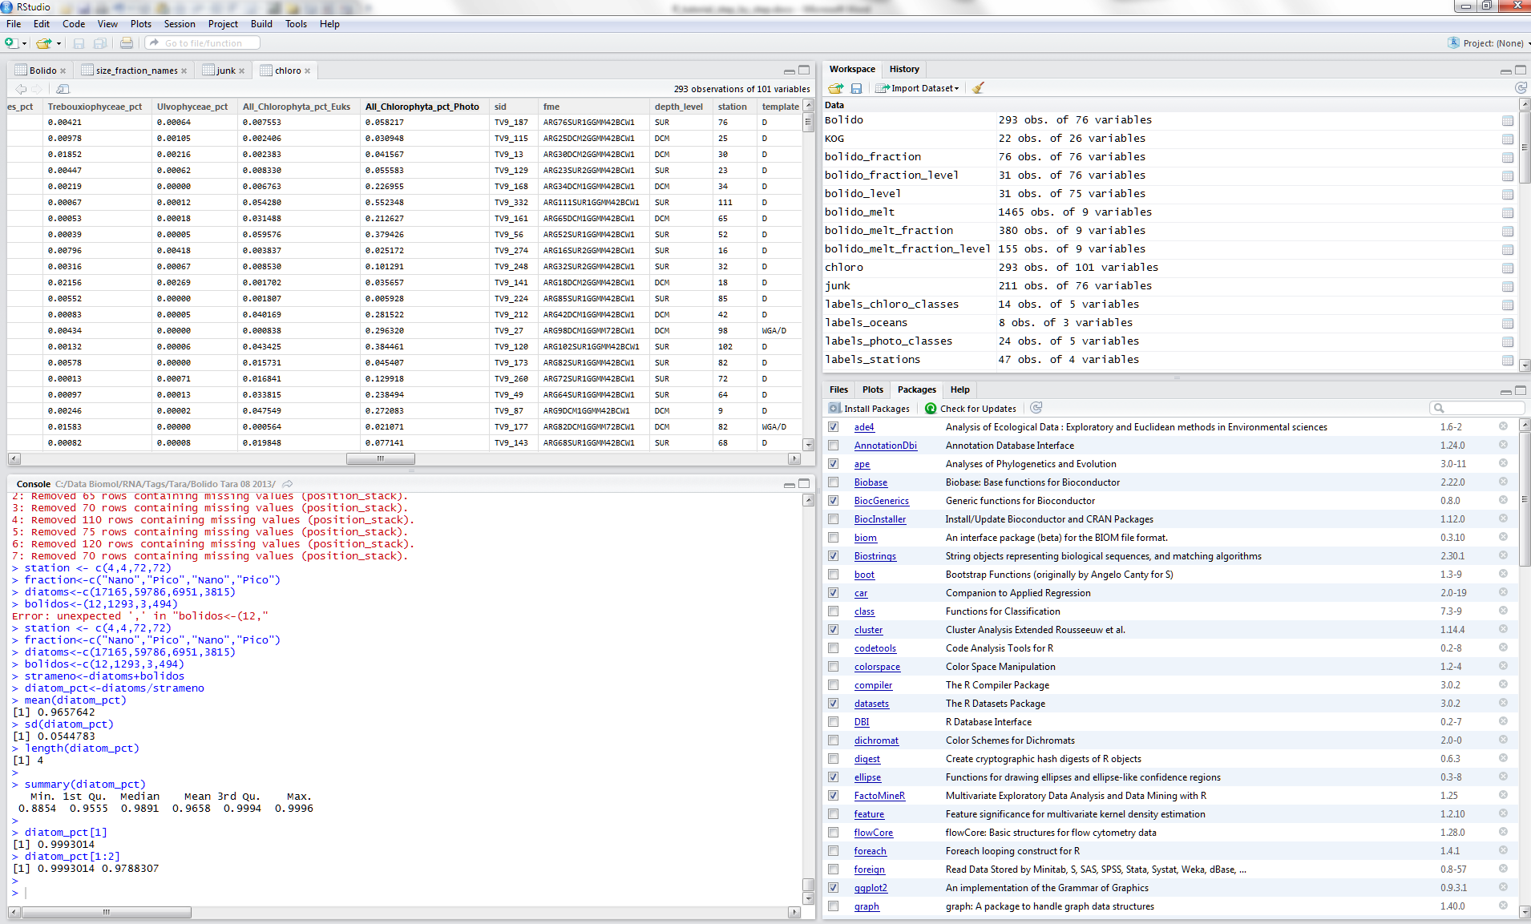
R studio

Slide 5

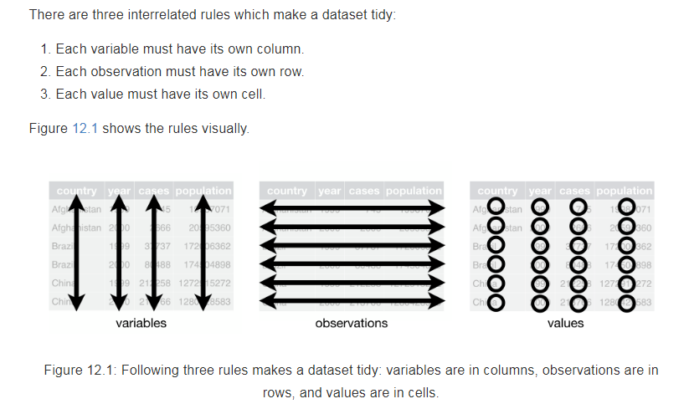
R for data science - A must read
http://r4ds.had.co.nz/

Slide 6
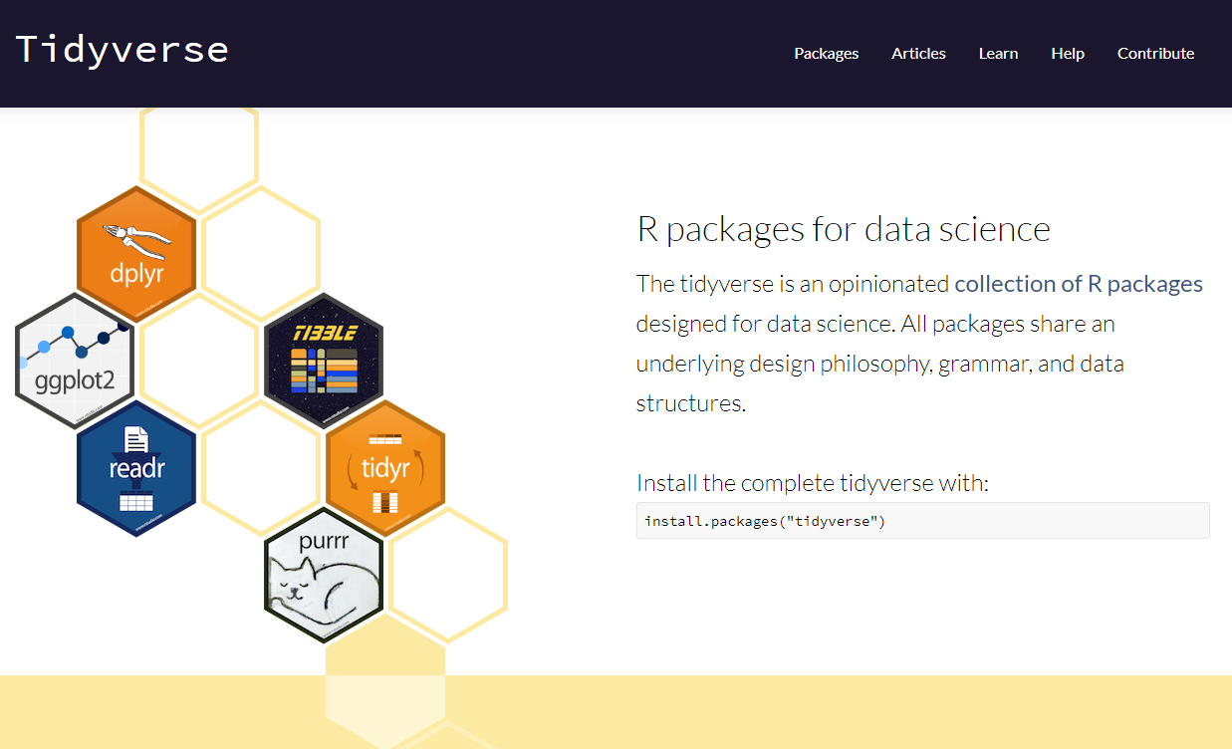
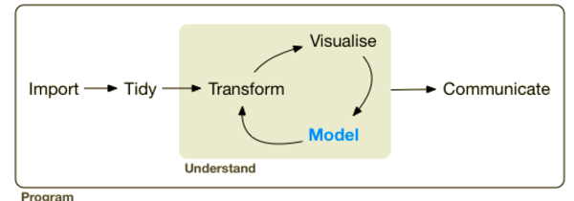
Tidyverse

Slide 7
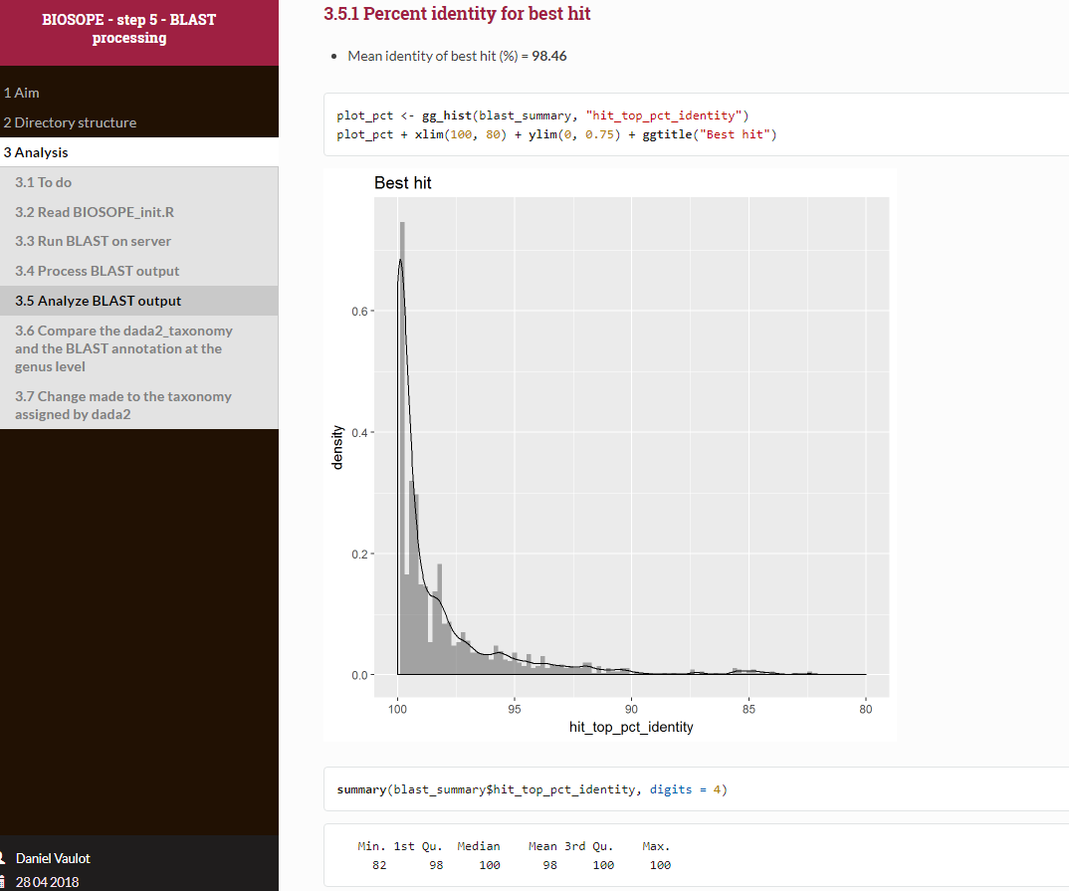
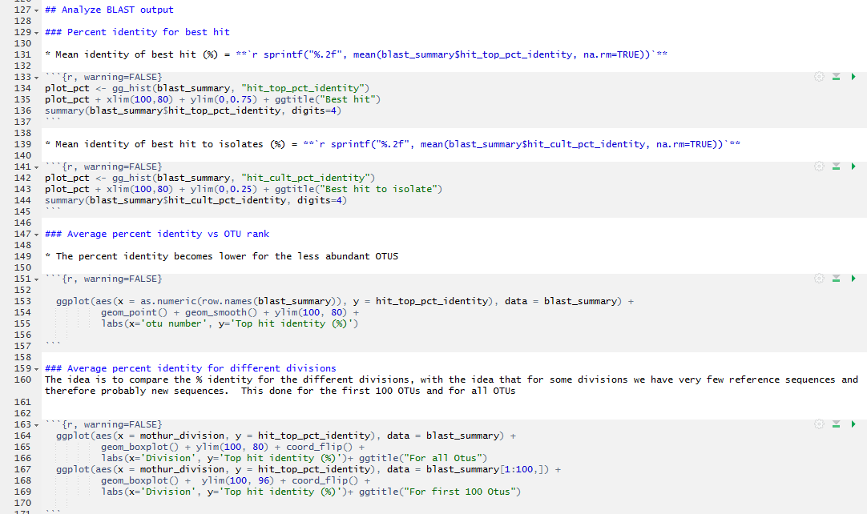
Document your work and recycle
Use Excel as little as possible....

Slide 8
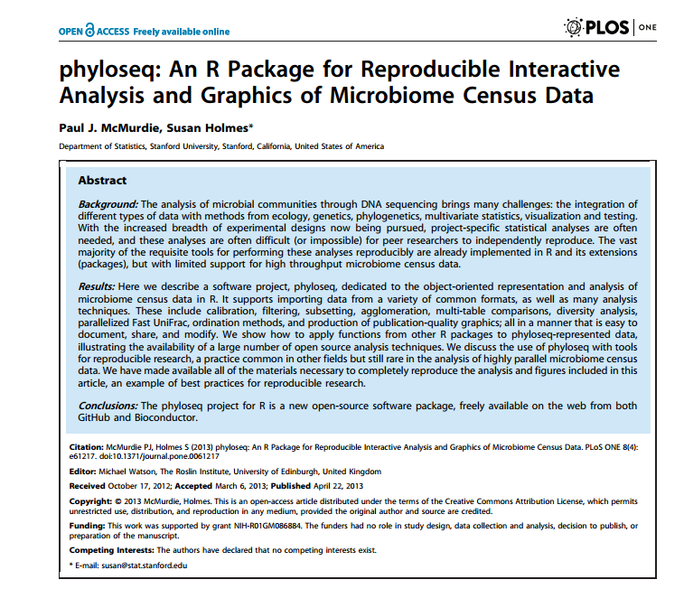

Slide 9
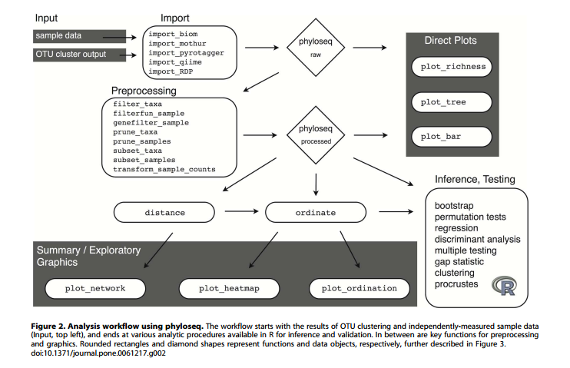

Slide 10
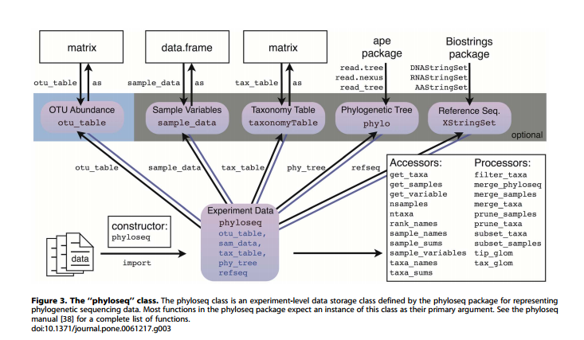

Slide 11
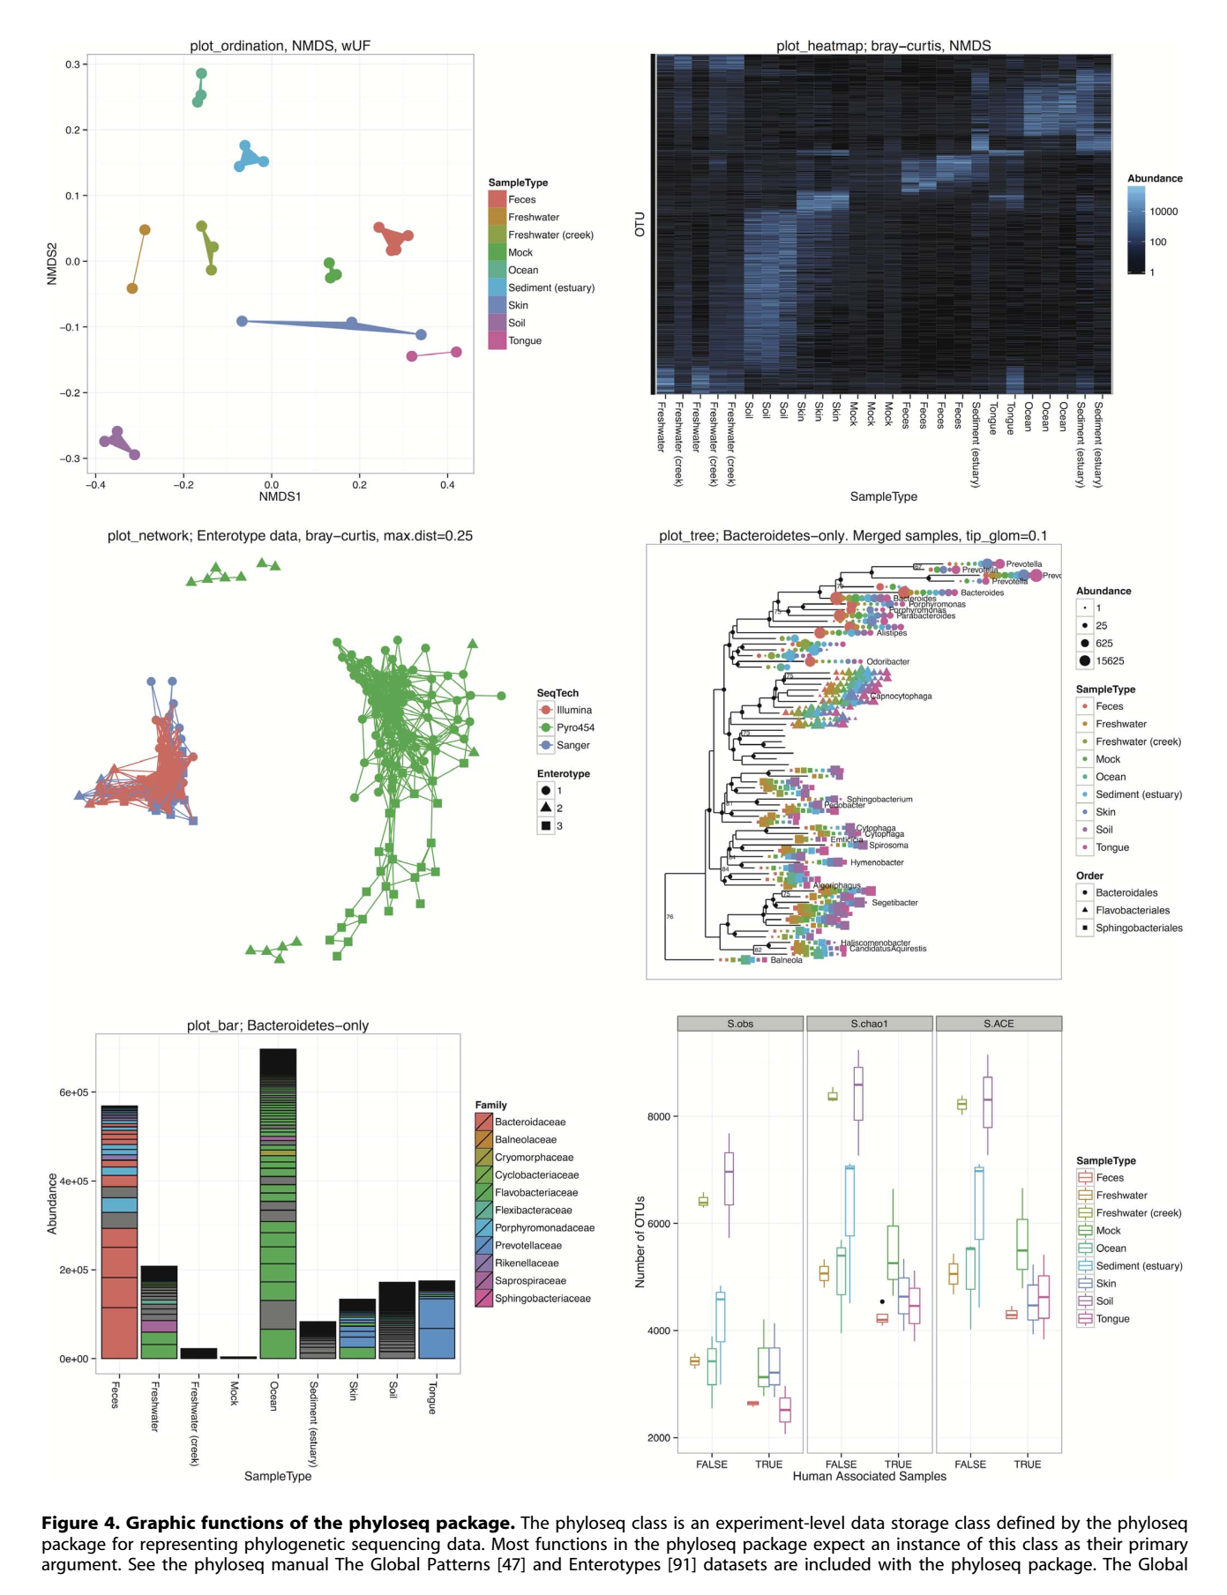

Slide 12
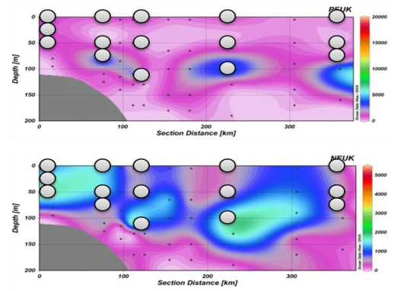
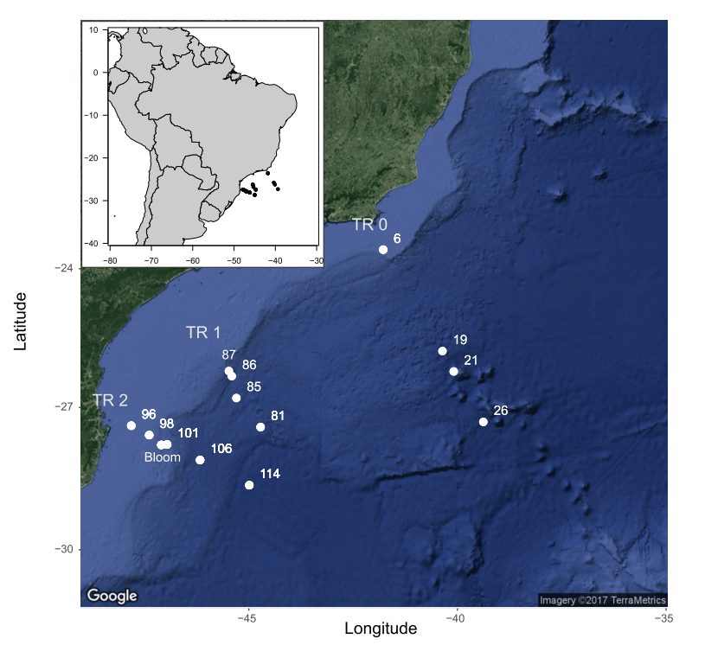
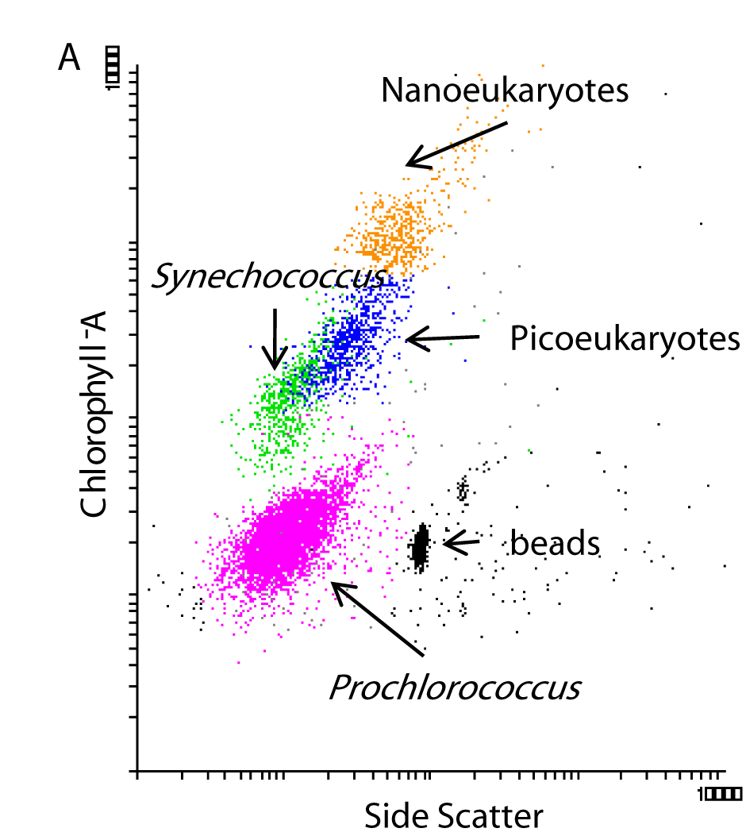
CARBOM cruise
Sorted samples
Pico vs Nano
Surf vs Deep
18S V4
Illumina 2*250 bp
C. Ribeiro and A. Lopes dos Santos, 2018

Slide 13
Preparation
Unzip files from phyloseq_tutorial.zip
Copy to local or remote directory
Open R studio either locally or on server
http://r.sb-roscoff.fr/
Open « phyloseq_tutorial.Rmd» with R studio
Set your working directory where the files are

Slide 14
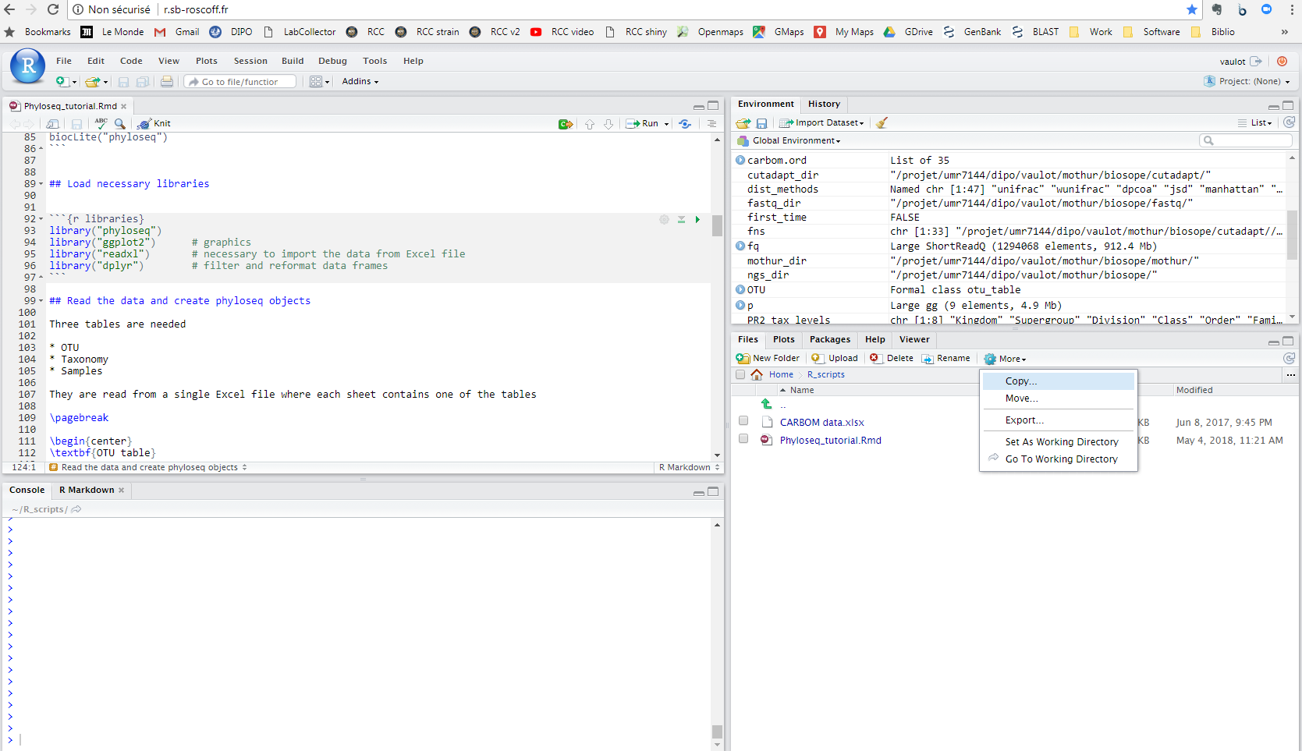

Slide 15
Import data
Necessary
OTU table
Taxonomy table
Sample variables
Optional
Tree
Sequences

Slide 16
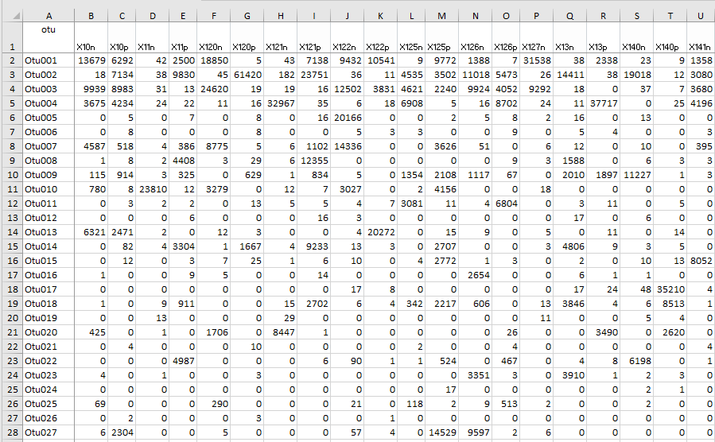
1 - Otu table

Slide 17
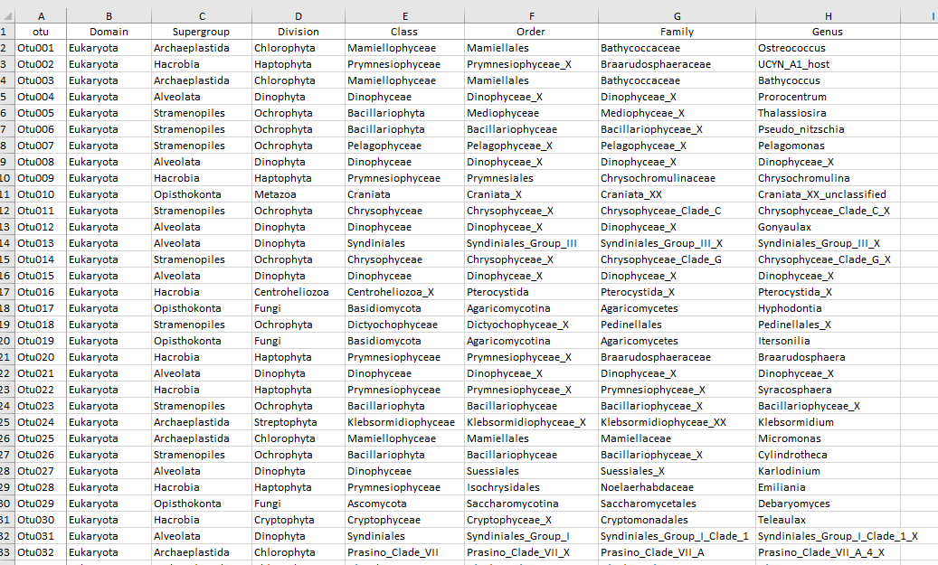
2 - Taxonomy Table

Slide 18
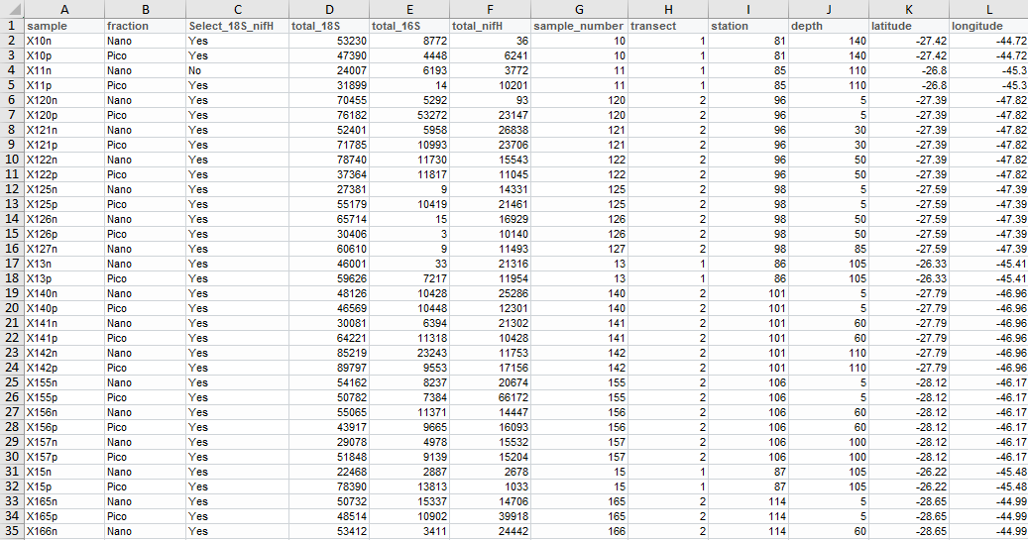
3 - Sample table

Slide 19
Steps
Import data
Combine into "phyloseq" object
Filter the data
taxonomy : e.g. only keep photosynthetic eukaryotes
samples : remove samples with low reads
abundance : remove OTUs with low abundance for some analyses
Barplots
Heatmaps
Alpha diversity
Multivariate analysis
Network analysis

Slide 20
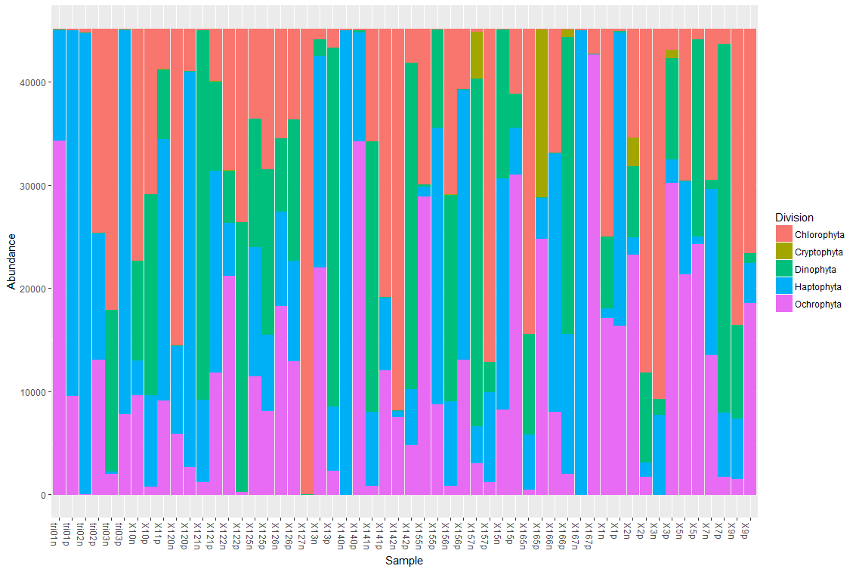
Barplots

Slide 21
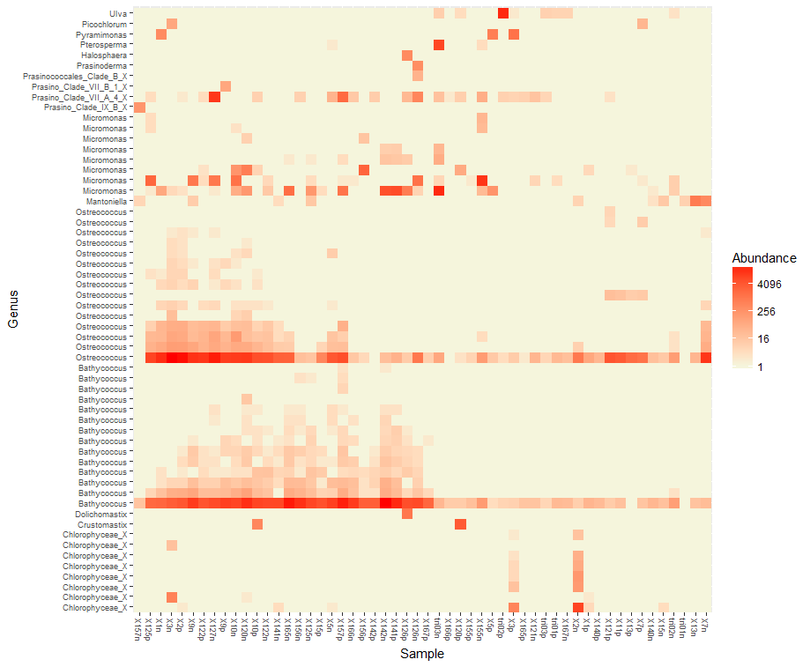
Heatmaps

Slide 22
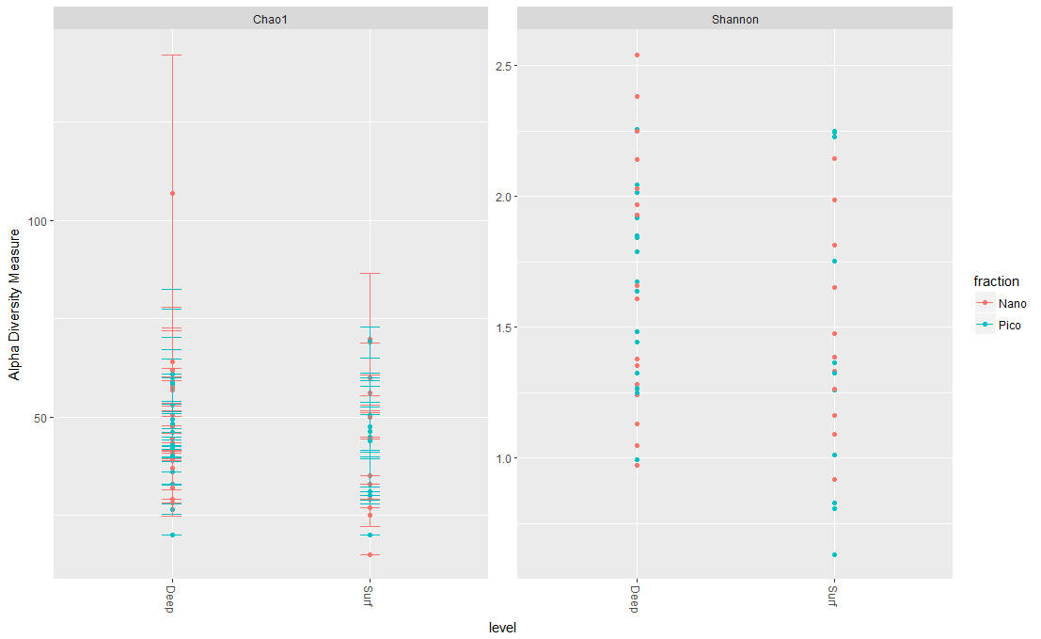
Alpha diversity

Slide 23
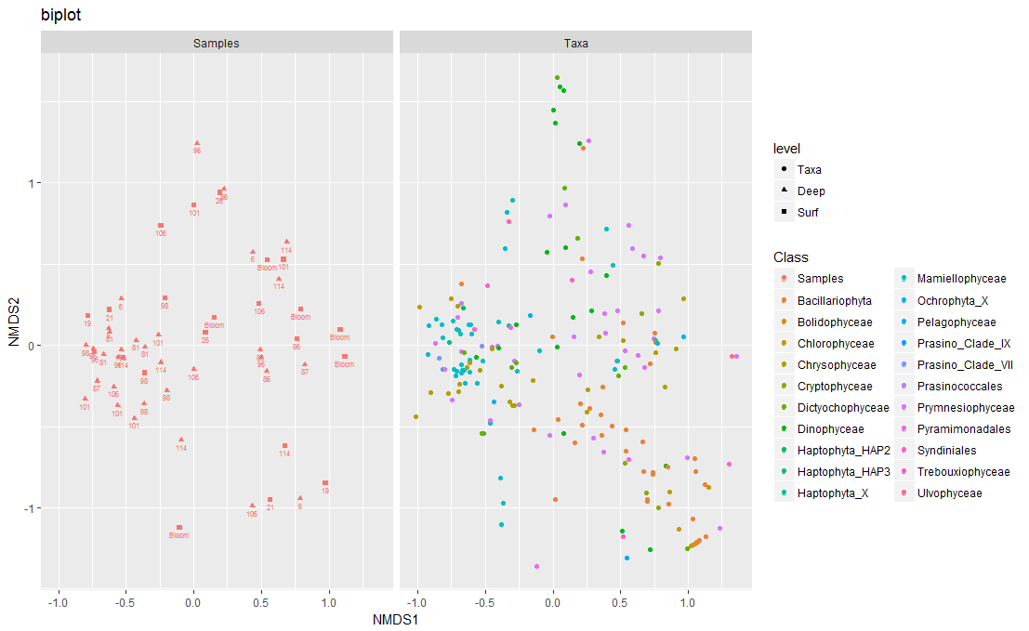
Multivariate analysis

Slide 24
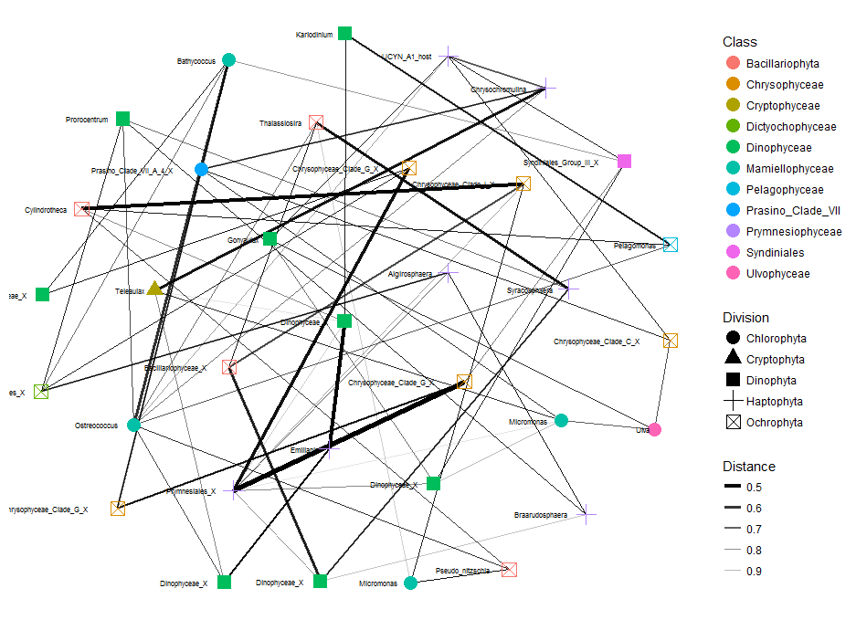
Network analysis

Slide 25
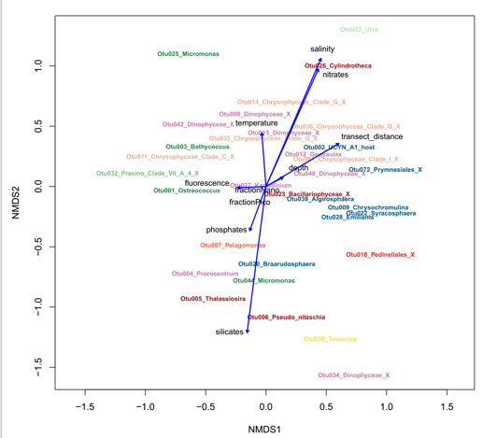
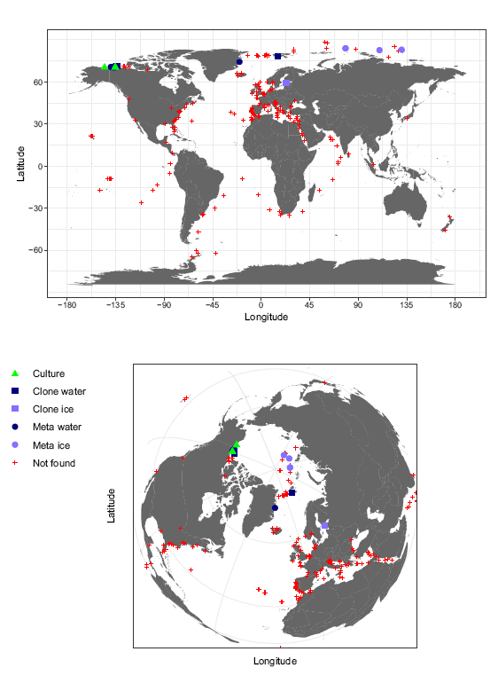
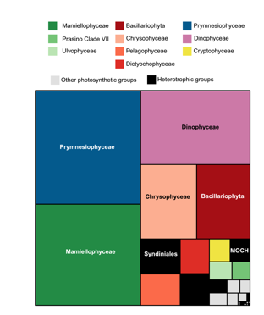
Other useful R packages
ggplot2
Best package for plotting things
vegan
Multivariate analyses
dplyr
Sorting, filtering, reformating data
maps
Plot the distribution of your data
treemaps
Summary plots
Tableau
Very intuitive software for data exploration

